Slide 1
SVNT Project
Shan Liu

Slide 2
Quick Sprint Planning Meeting
BrainStorming (Youtube features)
Separate Responsibilities(UI, Data, Backend)
Set time intervals

Slide 3
Our idea
Popular?
Catagories?
Region?
Views? (Past)
show Prediction?
UI part
User Profile Page ?
Video Uploading Page? (focus)

Slide 4
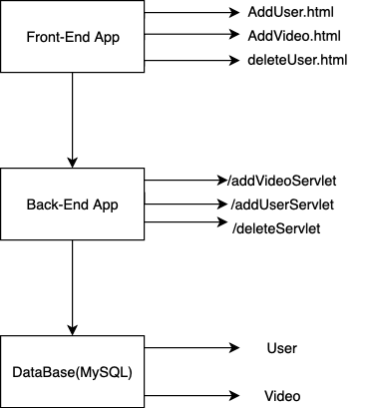
My Architecture

Slide 5
My Contribution
My idea is that we should keep our eye on the challenge in a limited time (Overwhelming)
To choose the feature that can be done from designer
Communicate with Data Scientist what the data does he expect from me
How will we define popular

Slide 6
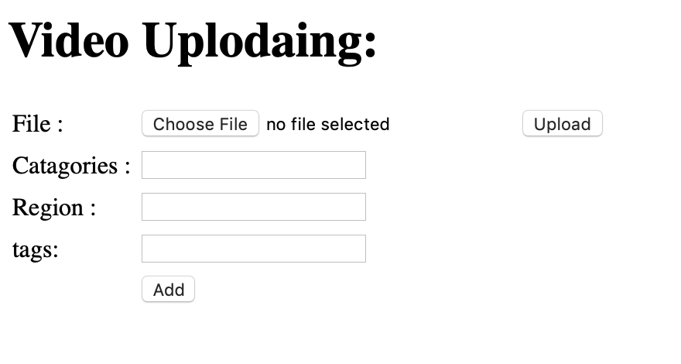

Slide 7
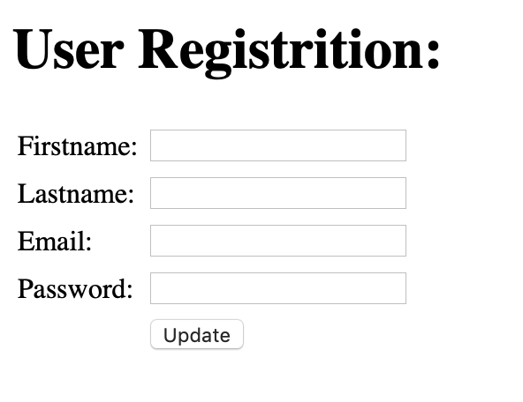

Slide 8
Future
link the Python file provided by Data Scientist -> we can get the actual predict result
May be add a user authentication -> So that we can had a channel id
Design a more well built front end page

